Slide 1
Lecture 20– Worms, Botnets
Michael Bailey
University of Illinois
ECE 422/CS 461 – Spring 2015

Slide 2
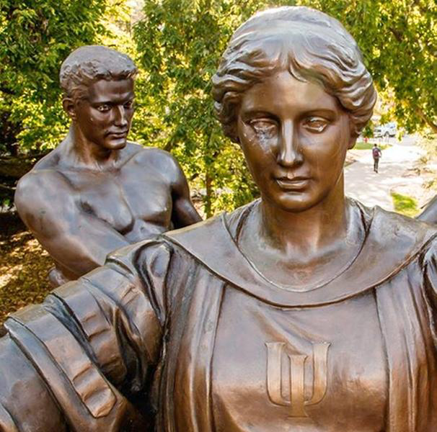
The early years: Cyber-Vandalism

Slide 3

”Virus-writers seemed, at least at first, to be in it for anything but money. The outcome was simply vandalism...Random strangers were anonymously discommoded. Somewhere, I assumed, someone had a rather abstract giggle.”
William Gibson, Author of Neuromancer

Slide 4
Worm
A worm is self-replicating software designed to spread through the network
Typically, exploit security flaws in widely used services
Can cause enormous damage
Launch DDOS attacks, install bot networks
Access sensitive information
Cause confusion by corrupting the sensitive information
Worm vs Virus vs Trojan horse
A virus is code embedded in a file or program
Viruses and Trojan horses rely on human intervention
Worms are self-contained and may spread autonomously

Slide 5
Cost of worm attacks
Morris worm, 1988
Infected approximately 6,000 machines
10% of computers connected to the Internet
cost ~ $10 million in downtime and cleanup
Code Red worm, July 16 2001
Direct descendant of Morris’ worm
Infected more than 500,000 servers
Programmed to go into infinite sleep mode July 28
Caused ~ $2.6 Billion in damages,
Love Bug worm: $8.75 billion
Statistics: Computer Economics Inc., Carlsbad, California

Slide 6
Internet Worm (First major attack)
Released November 1988
Program spread through Digital, Sun workstations
Exploited Unix security vulnerabilities
VAX computers and SUN-3 workstations running versions 4.2 and 4.3 Berkeley UNIX code
Consequences
No immediate damage from program itself
Replication and threat of damage
Load on network, systems used in attack
Many systems shut down to prevent further attack

Slide 7
Code Red
Initial version released July 13, 2001
Sends its code as an HTTP request
HTTP request exploits buffer overflow
Malicious code is not stored in a file
Placed in memory and then run
When executed,
Worm checks for the file C:\Notworm
If file exists, the worm thread goes into infinite sleep state
Creates new threads
If the date is before the 20th of the month, the next 99 threads attempt to exploit more computers by targeting random IP addresses

Slide 8
Manual Code Red Exploit
C:\ telnet www.targetsystem.com 80
GET/default.ida?NNNNNNNNNNNNNNNNNNNNNNNNNNNNNNNNNNNNNNNNNNNNNNNN
NNNNNNNNNNNNNNNNNNNNNNNNNNNNNNNNNNNNNNNNNNNNNNNNNNNNNNNNNNNNNNNN
NNNNNNNNNNNNNNNNNNNNNNNNNNNNNNNNNNNNNNNNNNNNNNNNNNNNNNNNNNNNNNNN
NNNNNNNNNNNNNNNNNNNNNNNNNNNNNNNNNNNNNNNNNNNNNNNN%u9090%u6858%ucb
d3%u7801%u9090%u6858%ucbd3%u7801%u9090%u6858%ucbd3%u7801%u9090%u
9090%u8190%u00c3%u0003%u8b00%u531b%u53ff%u0078%u0000%u00=a HTTP/1.0
“The vulnerability lies within the code that allows a Web server to interact with Microsoft Indexing Service functionality, which is installed by default on all versions of IIS. The problem lies in the fact that the .ida (Indexing Service) ISAPI filter does not perform proper "bounds checking" on user inputted buffers and therefore is susceptible to a buffer overflow attack.”
-sans.org

Slide 9
Code Red of July 13 and July 19
Initial release of July 13
1st through 20th month: Spread
via random scan of 32-bit IP addr space
20th through end of each month: attack.
Flooding attack against 198.137.240.91 (www.whitehouse.gov)
Failure to seed random number generator ⇒ linear growth
Revision released July 19, 2001.
White House responds to threat of flooding attack by changing the address of www.whitehouse.gov
Causes Code Red to die for date ≥ 20th of the month.
But: this time random number generator correctly seeded
Slides: Vern Paxson

Slide 10
Spread of Code Red
Network telescopes estimate of # infected hosts: 360K. (Beware DHCP & NAT)
Course of infection fits classic logistic.
Note: larger the vulnerable population, faster the worm spreads.
That night (⇒ 20th), worm dies …
… except for hosts with inaccurate clocks!
It just takes one of these to restart the worm on August 1st …
Slides: Vern Paxson

Slide 11
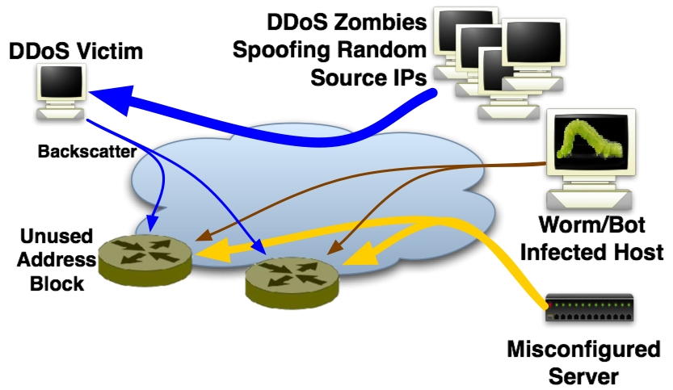
Network Telescopes
Network telescopes capture this scanning activity (as well as misconfigurations and backscatter) by observing unused addresses.
Bailey et al., The Internet Motion Sensor - A Distributed Blackhole Monitoring System (NDSS ’05)

Slide 12
Code Red 2
Released August 4, 2001.
Comment in code: “Code Red 2.”
But in fact completely different code base.
Payload: a root backdoor, resilient to reboots.
Bug: crashes NT, only works on Windows 2000.
Localized scanning: prefers nearby addresses.
Kills Code Red 1.
Safety valve: programmed to die Oct 1, 2001.
Slides: Vern Paxson

Slide 13
Striving for Greater Virulence: Nimda
Released September 18, 2001.
Multi-mode spreading:
attack IIS servers via infected clients
email itself to address book as a virus
copy itself across open network shares
modifying Web pages on infected servers w/ client exploit
scanning for Code Red II backdoors (!)
worms form an ecosystem!
Leaped across firewalls.
Slides: Vern Paxson

Slide 14
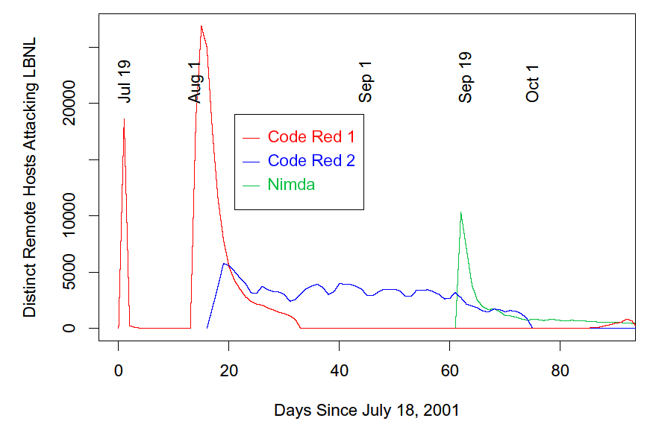
Code Red 2 kills off Code Red 1
Nimda enters the ecosystem
CR 1 returns thanks to bad clocks
Code Red 2 settles into weekly pattern
Code Red 2 dies off as programmed
Slides: Vern Paxson

Slide 15
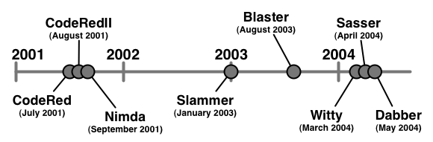
Early Worms
Worm |  | CodeRedII | Nimda | Sapphire | Blaster | Witty | Sasser | Dabber
Vulnerability |  | Index Server ISAPI Extension | Unicode Web Traversal CodeRedII Backdoor Open Shares | MS SQL Server 2000 and MSDE2000 | DCOM RPC | ISS/PAM ICQ module | LSASS (MS04-011) | Sasser-FTP
Infected Hosts |  | Millions | Millions | Hundreds of Thousands | Hundreds of Thousands | Tens of Thousands | Tens of Thousands | Thousands
Ports |  | TCP/80 | TCP/80 TCP/25 TCP/137- 139,445 | UDP/1434 | TCP/135 | UDP/4000 (src) | TCP/445 | TCP/5554
Notes:
Given routing complexity, dark address space will only grow!
Increased potential for outages and poor performance
Malicious exploitation looms
A single bad BGP message can disrupt the Internet. (Ex. claim a major carrier’s routes.)
Worms aren’t going away…
New worms will create a steady and increasing level of congestion
Huge number of zombies are available for use by anyone
Browser-based attacks loom
RESULT: becoming easier to launch increasingly devastating DoS attacks (Ex. root-name server flood; backbone router flood)
Peakflow 1.6 in late-November will have the robust Worm detection features and UI.

Slide 16
How do worms propagate?
Scanning worms : Worm chooses “random” address
Coordinated scanning : Different worm instances scan different addresses
Flash worms
Assemble tree of vulnerable hosts in advance, propagate along tree
Not observed in the wild, yet
Potential for 106 hosts in < 2 sec ! [Staniford]
Meta-server worm :Ask server for hosts to infect (e.g., Google for “powered by phpbb”)
Topological worm: Use information from infected hosts (web server logs, email address books, config files, SSH “known hosts”)
Contagion worm : Propagate parasitically along with normally initiated communication

Slide 17

Sherman, Set the Way Back Machine to 2000
Globally scoped, respecting no geographic
or topological boundaries.
At peak, 5 Billion infection attempts per day during Nimda including significant numbers of sources from Korea, China, Germany, Taiwan, and the US. [Arbor Networks, Sep. 2001]
Exceptionally virulent, propagating to the entire vulnerable population in the Internet in a matter of minutes.
During Slammer, 75K hosts infected in 30 min. [Moore et al, NANOG February, 2003]
Zero-day threats, exploiting vulnerabilities for which no signature or patch has been developed.
In Witty, "victims were compromised via their firewall software the day after a vulnerability in that software was publicized”
Bailey et al., The Internet Motion Sensor - A Distributed Blackhole Monitoring System (NDSS ’05)

Slide 18
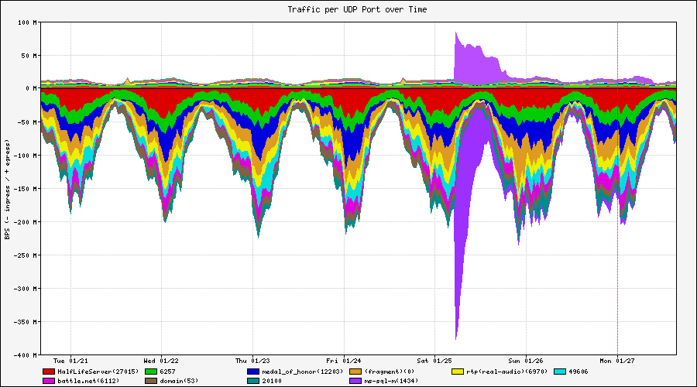
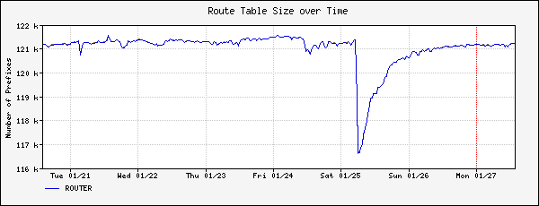
The Impact of Slammer (2003)
During Slammer, 75K hosts infected in 30 min.

Slide 19
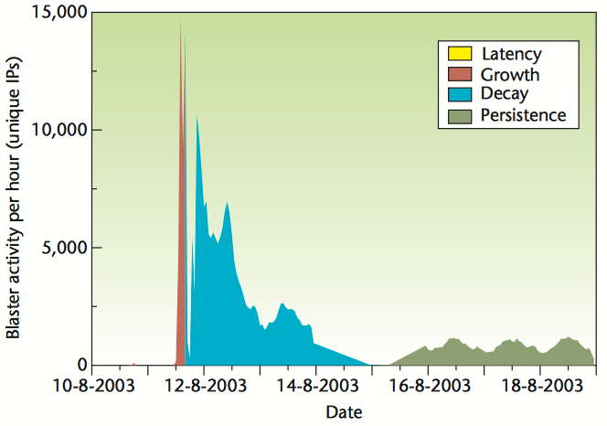
Blaster Worms Lifecycle
Blaster released on August 11, 2003
IMS Observed 286K IP addresses
Doubling every 2.3 hours
40,000 hosts/hour
Half-life = 10.4 hours
Bailey et al., The Blaster Worm: Then and Now (IEEE S&P ’05)

Slide 20
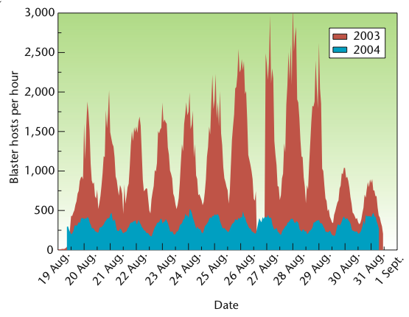
Blaster Worm Cyclic behavior and Persistence
Infected hosts still probing years later.
Something interesting was happening here…
Notes:
speculative

Slide 21
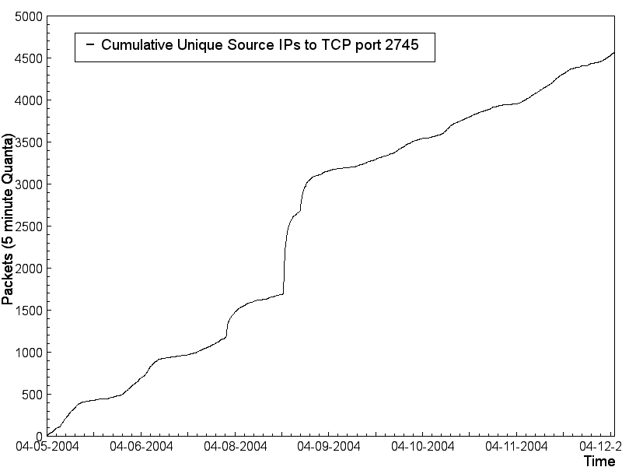
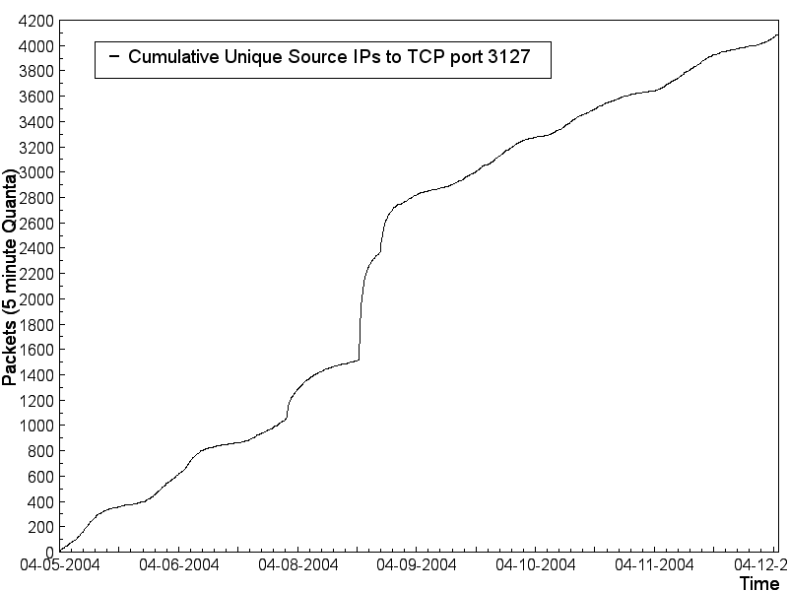
Bagle/MyDoom Backdoors
The backdoors left by viruses like Bagle and MyDoom are being probed
2745 = Bagle.C-G and J-K
3127 = MyDoom.A

Slide 22
Virulent Activity
This activity is not just benign scans
People are running programs on these boxes
00000000 85 13 3c 9e a2 4d 5a 90 00 03 00 00 00 04 00 00 |..<..MZ.........|
00000010 00 ff ff 00 00 b8 00 00 00 00 00 00 00 40 00 00 |.............@..|
00000020 00 00 00 00 00 00 00 00 00 00 00 00 00 00 00 00 |................|
00000030 00 00 00 00 00 00 00 00 00 00 00 00 00 00 00 00 |................|
00000040 00 f8 00 00 00 0e 1f ba 0e 00 b4 09 cd 21 b8 01 |.............!..|
00000050 4c cd 21 54 68 69 73 20 70 72 6f 67 72 61 6d 20 |L.!This program |
00000060 63 61 6e 6e 6f 74 20 62 65 20 72 75 6e 20 69 6e |cannot be run in|
00000070 20 44 4f 53 20 6d 6f 64 65 2e 0d 0d 0a 24 00 00 | DOS mode....$..|
00000080 00 00 00 00 00 df 3e 75 fb 9b 5f 1b a8 9b 5f 1b |......>u.._..._.|
00000090 a8 9b 5f 1b a8 18 57 46 a8 89 5f 1b a8 f4 40 10 |.._...WF.._...@.|
000000a0 a8 98 5f 1b a8 18 43 15 a8 9e 5f 1b a8 e0 43 17 |.._...C..._...C.|
000000b0 a8 9e 5f 1b a8 f4 40 11 a8 90 5f 1b a8 f4 40 1f |.._...@..._...@.|
000000c0 a8 9e 5f 1b a8 9b 5f 1a a8 7d 5f 1b a8 cf 7c 2b |.._..._..}_...|+|
000000d0 a8 9a 5f 1b a8 cf 7c 2a a8 a2 5f 1b a8 52 69 63 |.._...|*.._..Ric|
000000e0 68 9b 5f 1b a8 00 00 00 00 00 00 00 00 00 00 00 |h._.............|
000000f0 00 00 00 00 00 00 00 00 00 00 00 00 00 50 45 00 |.............PE.|
00000100 00 4c 01 03 00 2d bc 4f 3e 00 00 00 00 00 00 00 |.L...-.O>.......|
00000110 00 e0 00 0f 01 0b 01 06 00 00 50 01 00 00 10 00 |..........P.....|
00000120 00 00 f0 02 00 d0 45 04 00 00 00 03 00 00 50 04 |......E.......P.|
00000130 00 00 00 40 00 00 10 00 00 00 02 00 00 04 00 00 |...@............|
00000140 00 00 00 00 00 04 00 00 00 00 00 00 00 00 60 04 |..............`.|
...
000001f0 00 00 00 00 00 55 50 58 30 00 00 00 00 00 f0 02 |.....UPX0.......|
00000200 00 00 10 00 00 00 00 00 00 00 04 00 00 00 00 00 |................|
00000210 00 00 00 00 00 00 00 00 |........|
UPX
Packed
Binary
Payload

Slide 23
Why?
Wed May 19 23:58:15 EDT 2004
1085025451 00501338 24.150.154.217 4141 > 141.212.123.138 5000 TCP
1085025451 00501360 24.150.154.217 4141 > 141.212.123.138 5000 TCP
Fri, 21 May 2004 07:19:37 -0400 (EDT)
Received: from d150-154-217.home.cgocable.net (d150-154-217.home.cgocable.net [\
24.150.154.217])
by crimelabs.net (Postfix) with SMTP id 78299DEDB
for <XXX>; Fri, 21 May 2004 07:19:37 -0400 (EDT)
Received: from 24.150.154.217 by 88.10.208.96 Fri, 21 May 2004 11:10:57 -0100
Message-ID: <qfmibfhpnvjAaKznbMPJRT1laK@hotmail.com>
From: "abolish" <Alphonsozyhs@msn.com>
Reply-To: "abolish" <Alphonsozyhs@msn.com>
To: XXX
Subject: this is what you asked for

Slide 24
Attacker Ah Ha! Moment
A compromised system is more useful alive than dead!
A compromised system provides anonymity
A network of compromised hosts provides a powerful delivery platform

Slide 25
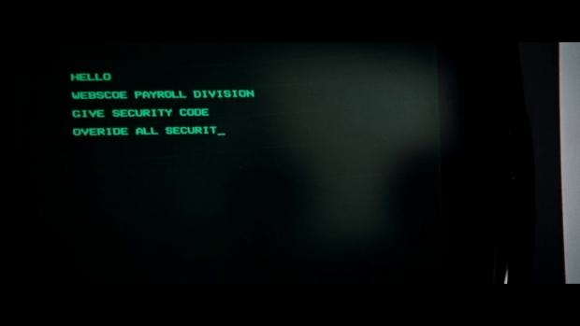
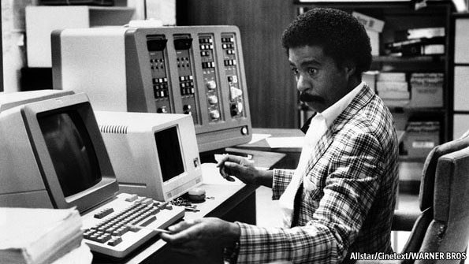
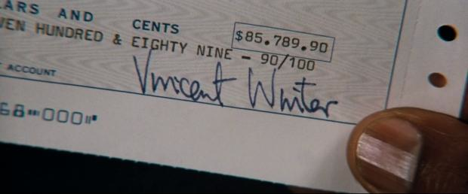
The rise of botnets: Cyber-Crime
Notes:
“3. Protect the United States against cyber-based attacks and high-technology crimes”
US Federal Bureau of Investigation (FBI)’s website listing cyber crime as the FBI’s third highest priority behind such dramatic threats as counter- terrorism and counter-espionage.
The annual loss due to computer crime was estimated to be $67.2 billion for U.S. organizations, according to a 2005 Federal Bureau of Investigation (FBI) survey.

Slide 26

The rise of botnets: Cyber-Crime
“3. Protect the United States against cyber-based attacks and high-technology crimes”
US Federal Bureau of Investigation (FBI)’s website listing cyber crime as the FBI’s third highest priority behind such dramatic threats as counter- terrorism and counter-espionage.
The annual loss due to computer crime was estimated to be $67.2 billion for U.S. organizations, according to a 2005 Federal Bureau of Investigation (FBI) survey.
Notes:
After worms, global Internet threats underwent a profound transformation from attacks designed solely to disable infrastructure to those that also target people and organizations. This alarming new class of attacks directly impacts the day-to-day lives of millions of people and endangers businesses and governments around the world. For example, computer users are assailed with spyware that snoops on confidential information, spam that floods email accounts, and phishing scams that steal identities.

Slide 27
Botnets represent today’s attack platform
DoS Extortion, Identity Theft, Phishing, SPAM, Spyware

Slide 28


Slide 29
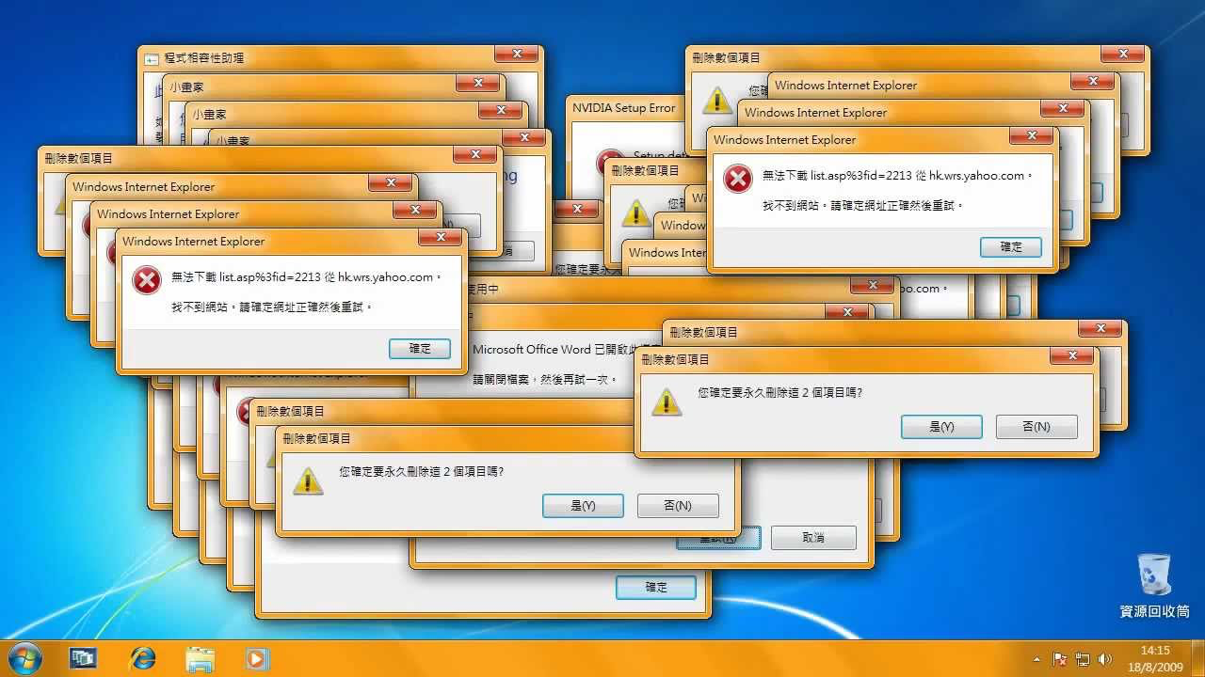

Slide 30
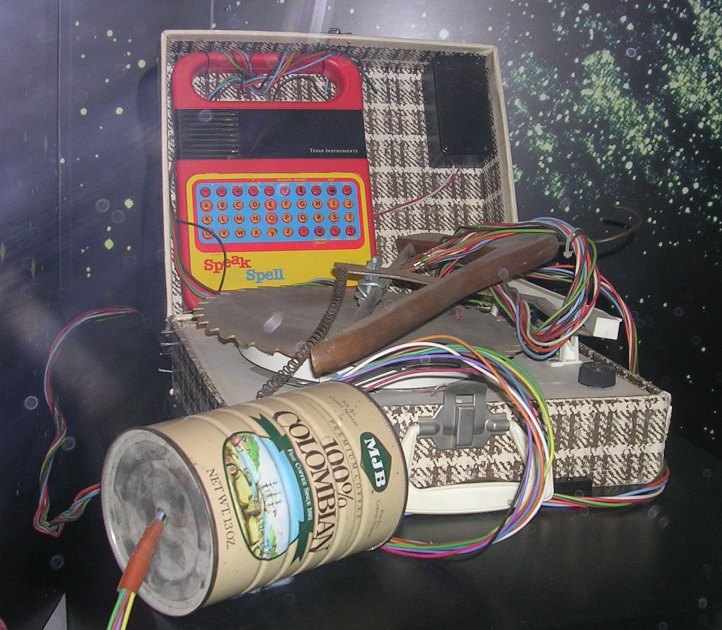

Slide 31


Slide 32

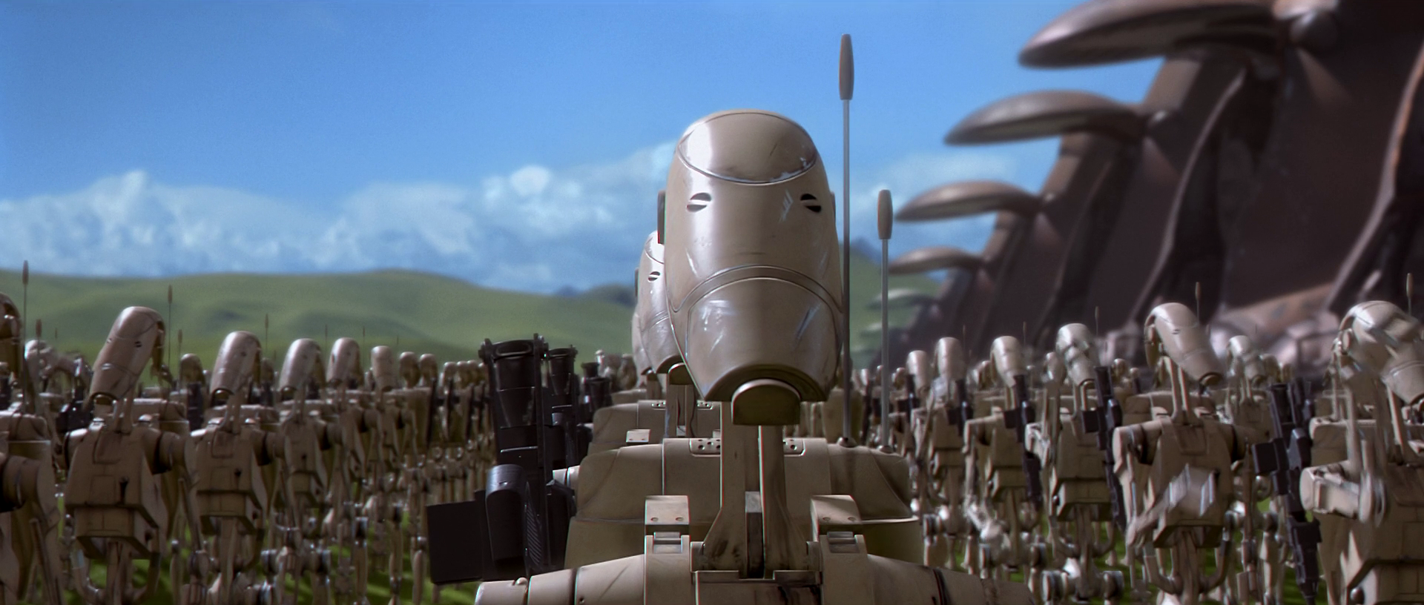

Slide 33
What’s a “botnet”?
A bot is a servant process on a compromised system
Usually installed by a trojan, though worms have evolved to install bots as well (e.g., deloder)
Communicates with a handler or controller, often running on public IRC servers or other compromised systems
Almost always unbeknownst to the systems owner - ‘got bot?’
A botmaster or botherder commands bots to perform any of an array of different functions
System of bots and controller(s) is referred to as a botnet or zombie network
Cooke et al., The Zombie Roundup: Understanding, Detecting, and Disrupting Botnets (SRUTI ’05)

Slide 34
A Botnet lifecycle framework
We maintain that all bots MUST exhibit these lifecycle behaviors:
Propagation: To recruit new members, bots rely on an array of built-in propagation vectors.
Communication: After a new infection, a bot establishes a C&C connection with a controller.
Attacks: Malicious bots attack Internet users and infrastructure.

Slide 35
Ecosystem complexity
Attack ecosystem complexity is increasing at a dramatic rate
?
Encrypted P2P
Botnets
Nugache
Storm
Worms
Slammer
Blaster
2012
Complexity
IRC Botnets
SDBot
Agobot
2008
2001
2004
Time

Slide 36
Botnet evolving propagation
Attacks moving “up” (i.e., application attacks, social engineering)
People continue to be the weakest link
Web centric (e.g., browsers as operating systems)
Targeted behaviors
Piggyback on other’s trust

Slide 37
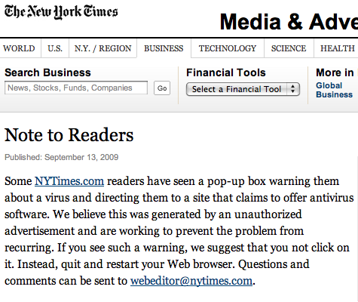
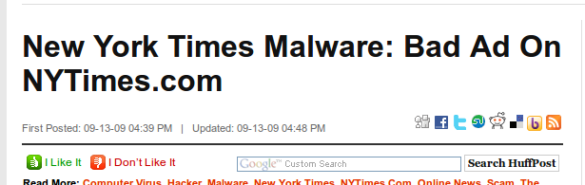
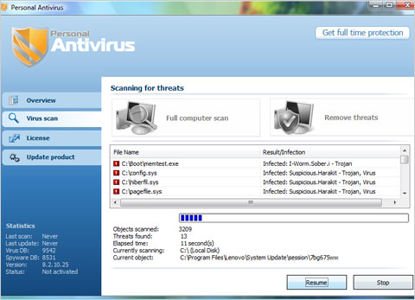
Application level attack: the drive-by
Today email and other application-level functions laden with Trojans
Now delivered via web sites - drive-by installs
Projected 1 in 10 web sites hosts malicious content
Web-based delivery means outpacing email, viruses, etc..

Slide 38
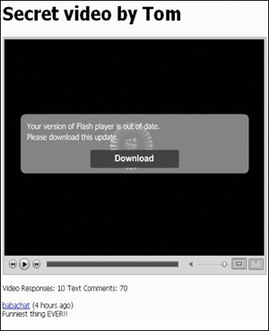
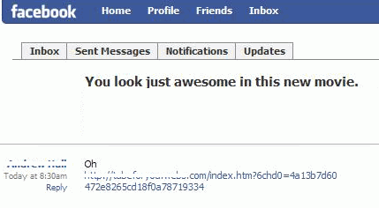
Social networking and messaging
Koobface:
Attackers using social networks to spread via social engineering and internal messaging
Difficult to maintain visibility into these vectors to collect and analyze malware
Notes:
those are images of the koobface message/fake video

Slide 39
Evolving botnet topologies and communication
More resilient topologies
Obfuscating C&C
Hide in the open (e.g., Twitter, Google App Engine)
Encryption
Agility
Fast flux
Domain generation algorithms

Slide 40
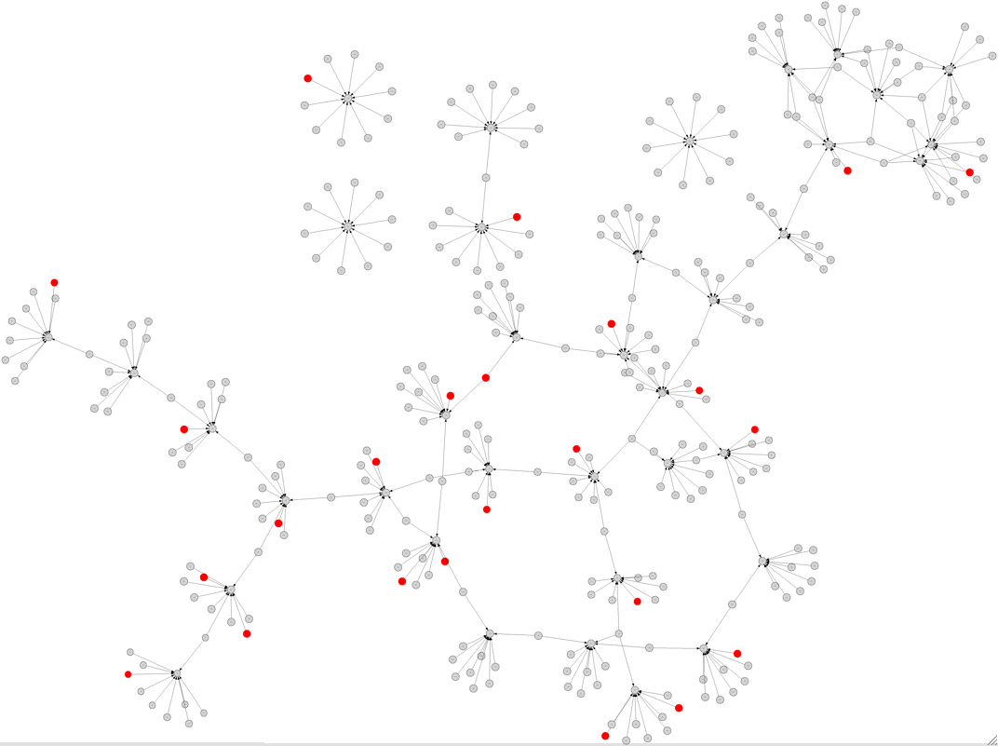
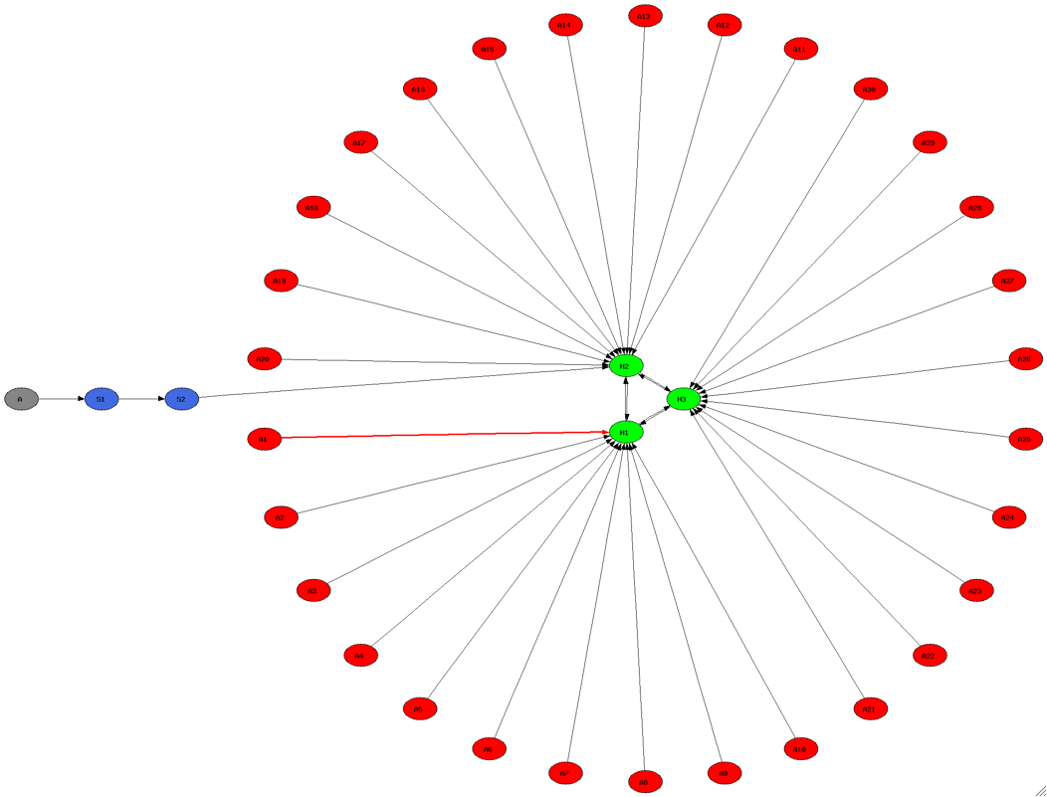
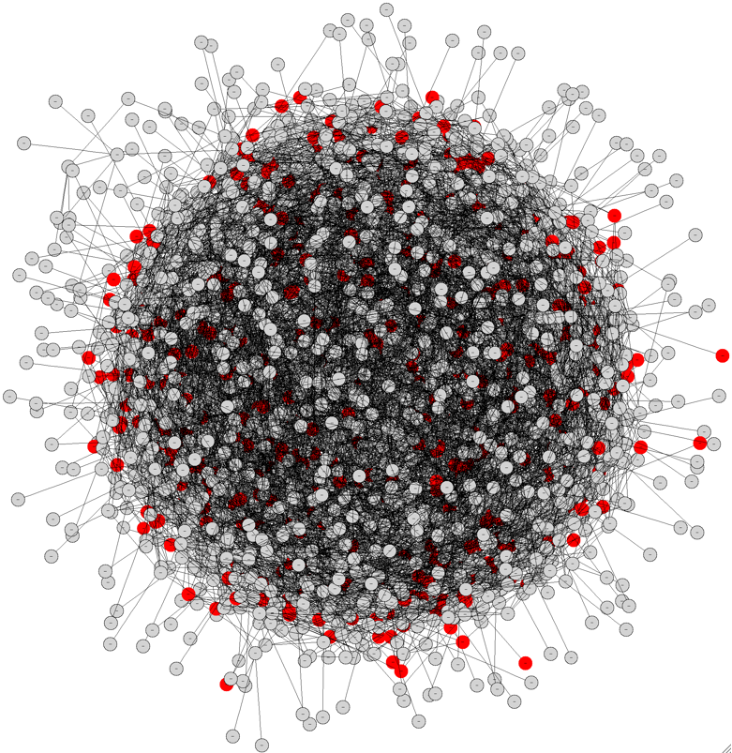
E.g., more resilient structures
A
B
Notes:
A is a typical IRC based botnet structure
B is nugache

Slide 41

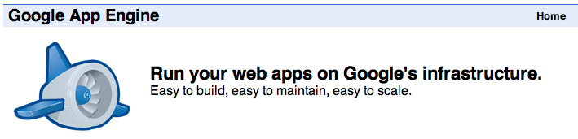
E.g., more scalable and reliable communications?
Why write application in Google’s app engine?
Easy to get Started
Automatic scalability
The reliability, performance and security of Google's infrastructure
Cost efficient hosting
Risk free trial period
http://xiaoiboxip.appspot.com/[OMITTED]?hostname=&&systemcpoy=&&userName=
cmd
<br>http://XX.XX.76.85/aa.exe</br>
MD5: 2143a7b9a9de6ea26987ed8ece29d2c6
SHA1: 30f6befc76e4e269e5aa9c01c735d55d7ca4099a
File type: application/x-ms-dos-executable
File size: 65024 bytes
aa.Exe
(PCClient Backdoor)

Slide 42
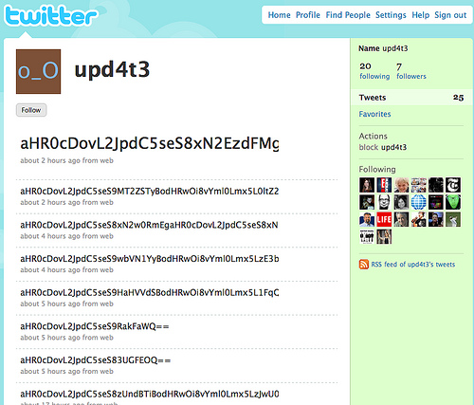
E.g., Tweeting C&C

Slide 43
Evolving botnet attacks
Impact (e.g., shift towards HTTP GET floods in DDoS campaign)
Targeted Attacks

Slide 44
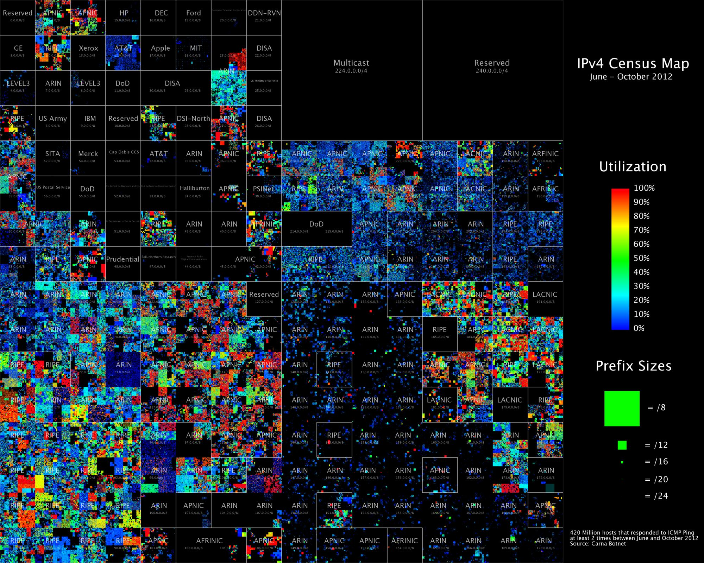
© Internet Census 2012
Notes:
Information and communications technology (ICT) is important.
Take for example the Internet:
1.7 billion users
40 Tbps of inter-domain traffic and an annual growth rate of 44.5%
estimated $1.5 trillion in annual global economic benefits

Slide 45
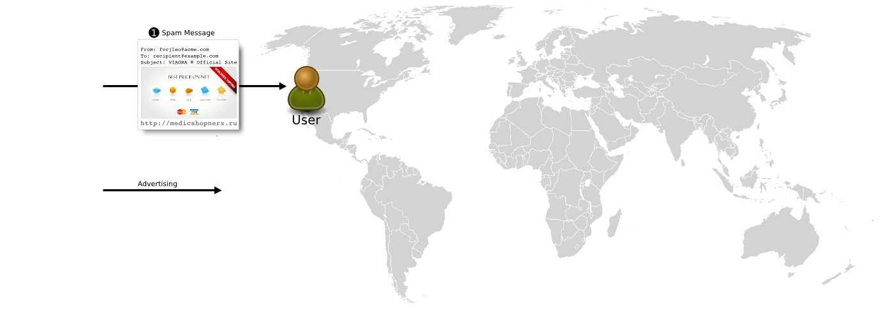

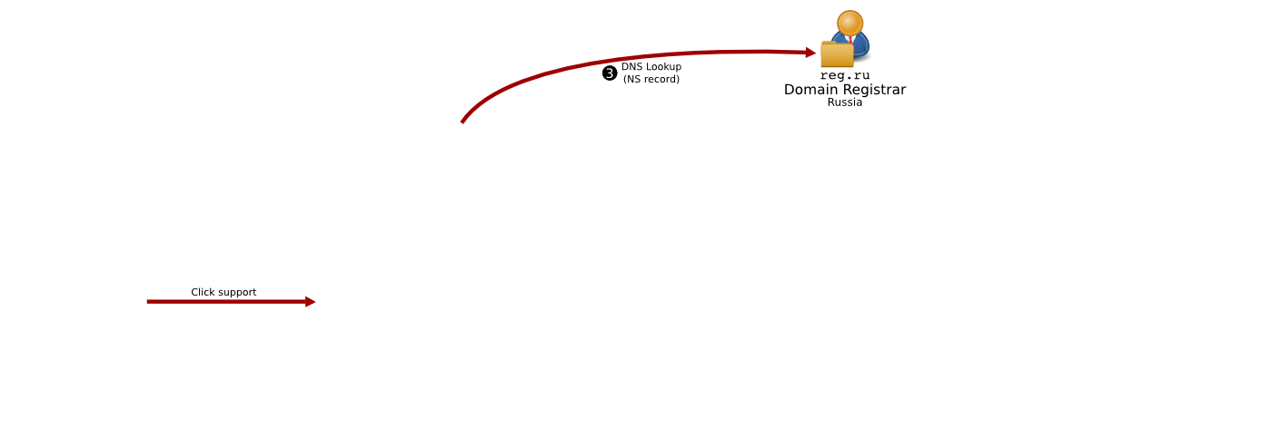
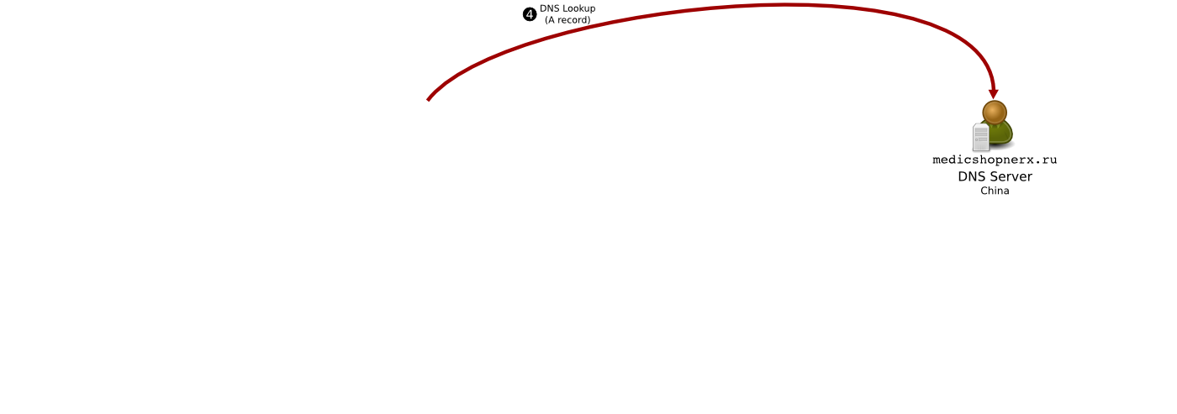

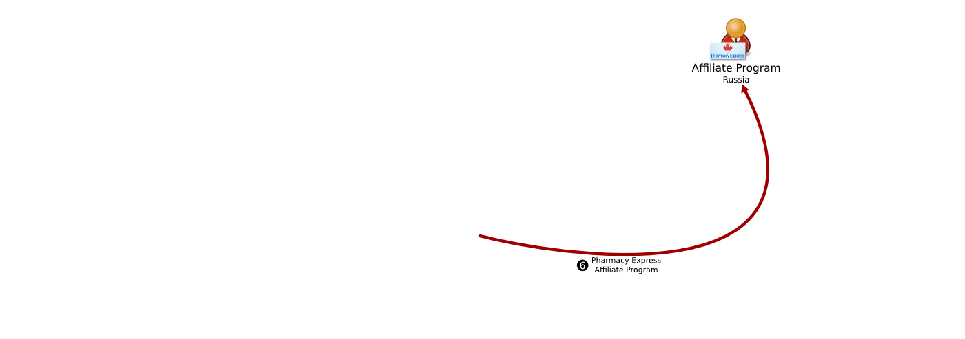
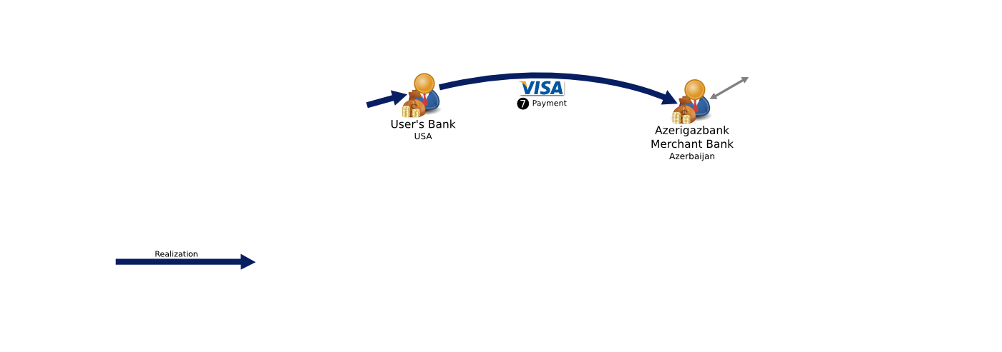
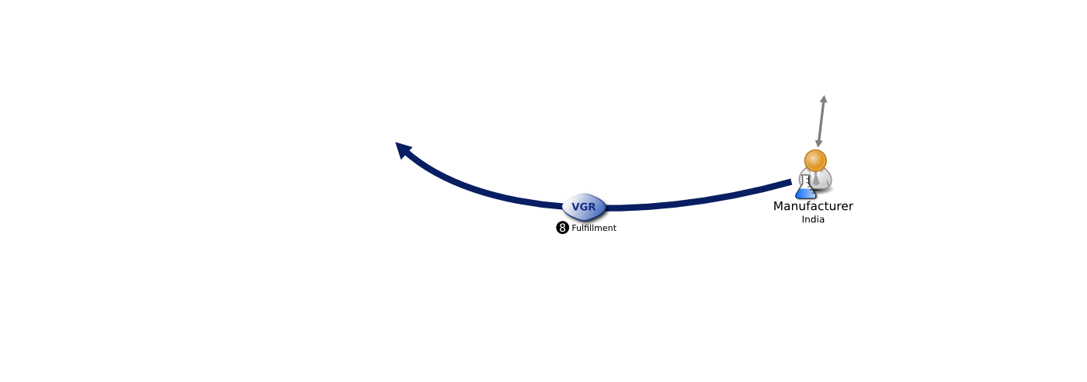
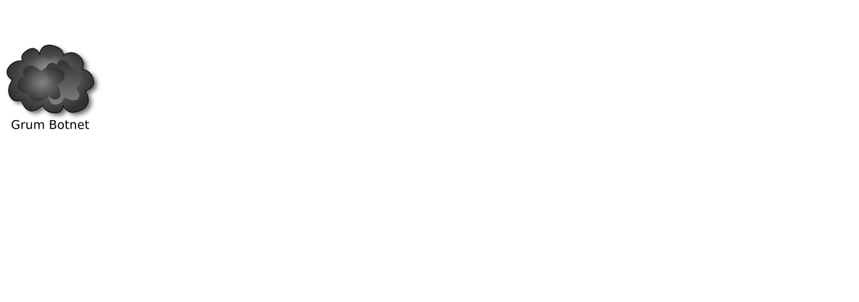

The Spam “Value Chain”
Notes:
dentifying the "bottleneck" of credit card banking to wide variety of
online scams (most abusive advertising, counterfeit pharma, replica
luxury goods, fake anti-virus, etc) and identifying the economics and
social structure of the organizations behind these scams
* Helped drive major anti-counterfeiting effort being used by brands
Context: based on our work we were contacted by Victoria Espinel in
EOP and connected with the International Anti-Counterfeiting
Coalition, we in turn helped them design their "Portal Program" by
which brands are able to identify infringing sites and request that
their merchant accounts be terminated.
* Worked with individual brands to evaluate efficacy of approach
* For-profit sale of counterfeit Microsoft software online has
basically been eliminated (huge success)
* Almost half of counterfeit online pharmacy programs put out of
business as a result
* Have provided detailed intel and data to FBI, DEA, FDA OCI,

Slide 46

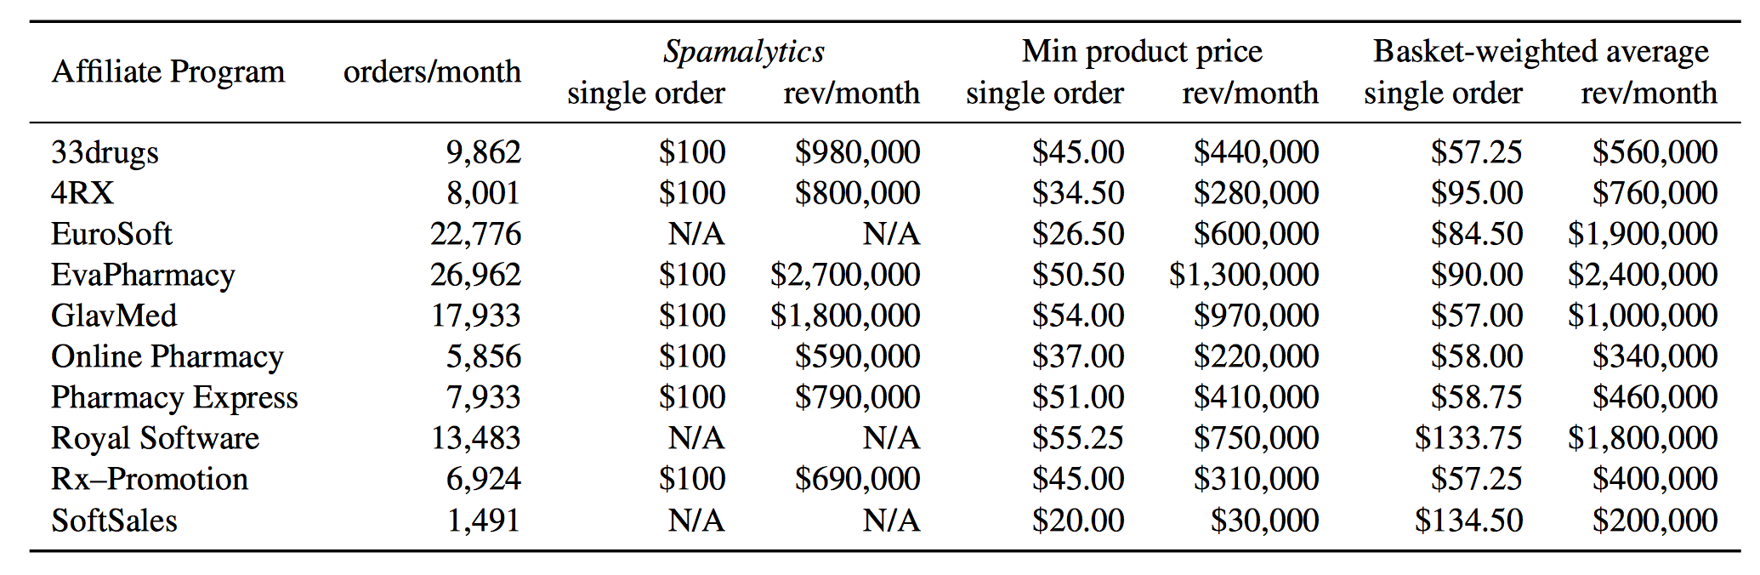
Kanich et al., Show Me the Money: Characterizing Spam-advertised Revenue. The Economist, 2011

Slide 47
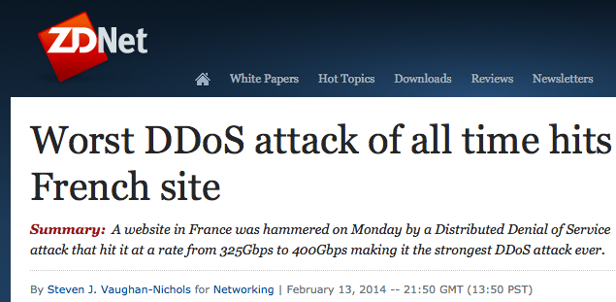
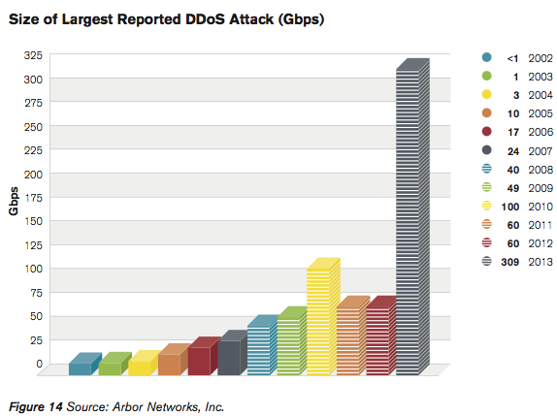
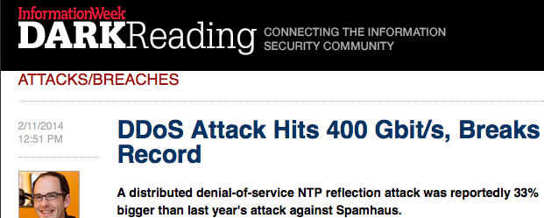
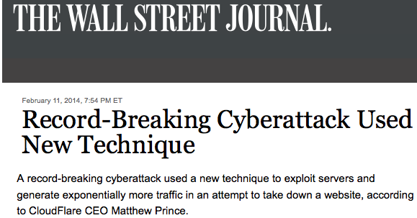
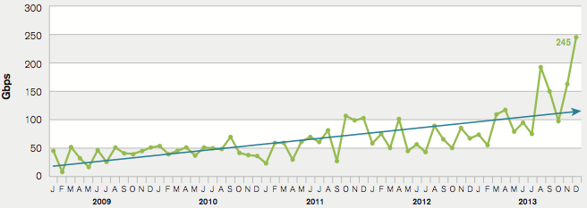
The DDoS “Hockey Stick Era”
Notes:
In the second week of February the tech news bubble was quite abuzz regarding a DDoS attack on the French hosting provider OVH. [PAUSE]
Now, DDoS attacks have been around for years, of course, but this one caught people’s eye for two reasons: First, [CLICK] it was the largest ever reported--clocking in at around 400 gigabits per second.
Secondly, this attack included a technique that had been nearly unheard of just several months prior, but which had started to gain momentum starting in December.
Basically, by taking advantage of network time protocol diagnostic features, miscreants were able to amplify their attack traffic to an extent that the world had not previously seen. Someone even dubbed it the hockey stick era of DDoS.
(another early ref: http://www.symantec.com/connect/blogs/hackers-spend-christmas-break-launching-large-scale-ntp-reflection-attacks)

Slide 48
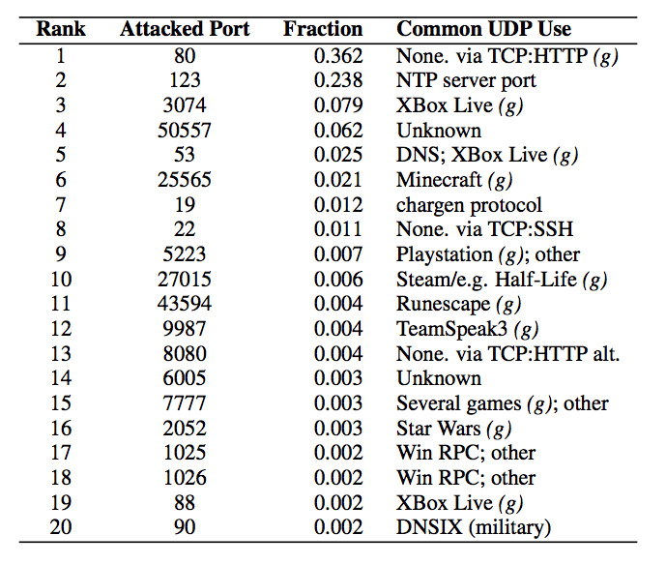
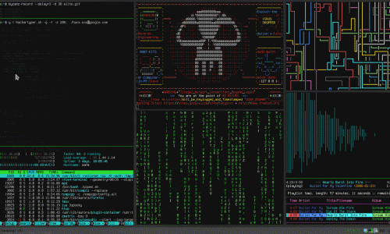
Top Attacked Ports
Notes:
Also, by aggregating the attacked ports, we were able to get a sense of what applications the attackers may have been most interested in disrupting. [CLICK]
This chart shows the top twenty ports that appeared to be targeted either deliberately or due to the scripts/tools that attackers were using.
We see that 36% of the NTP attacks were directed toward UDP port 80, perhaps because they wanted to attack web servers and lacked clue or because they thought somehow filters or firewalls would allow more of these UDP port 80 packets through.
Remember that these types of DDoS attacks are volumetric, and so they mainly intend to eat up bandwidth on the target in general, not necessarily to disrupt specific aps.
[CLICK] Still, we note that 10 of the top 20 ports were associated with games or gaming systems. The likely gaming-related targets were at least 15% of seen attacks.
This is congruent with industry and press reports that claim that much DDoS activity occurs between competing gamers either for revenge, gaming advantage, or financial gain, as many game tournaments involve money.

Slide 49

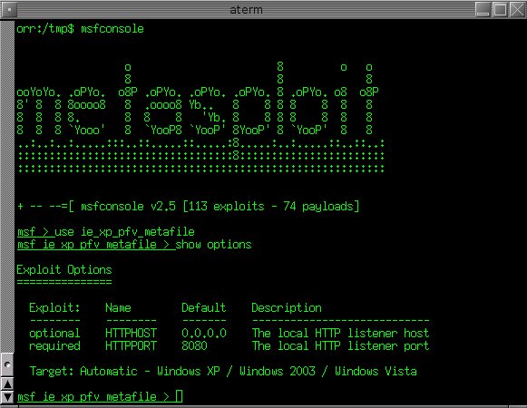
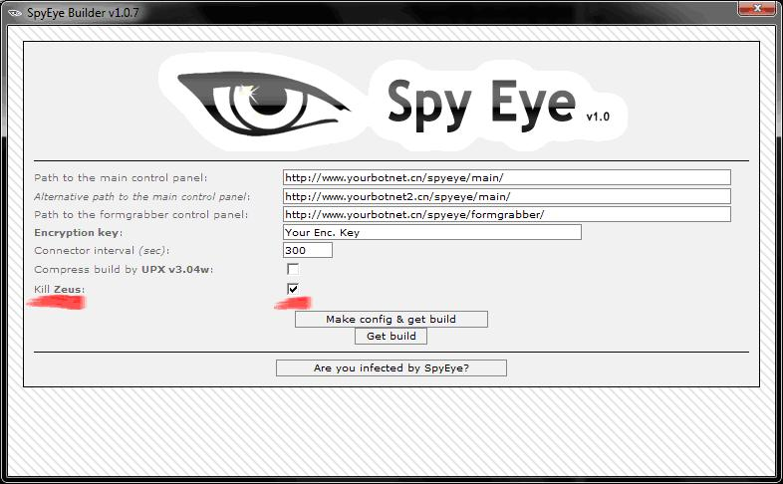
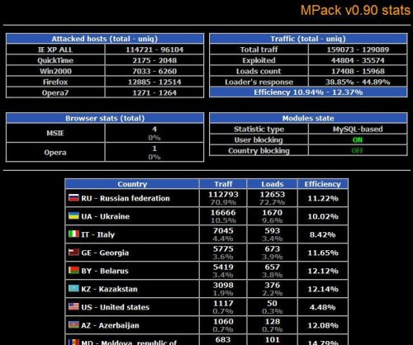
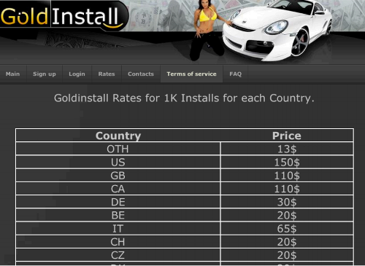

Infrastructure
Exploit packs
Spam Services
DeCaptcha and
Packing Services
Botnet
Toolkits
Pay per Install
Cloud Type | Legitimate | Crimeware
IaaS | Amazon EC2, Mosso | Renting out infected bots
PaaS | Google App Engine, Azure | Botnet-backed spam services
SaaS | SalesForce, SAP ByDesign | Packing services, Decaptcha!
Notes:
While reuse and sharing have been key components of previous stages of threat evolution, we envision that new service-based models of deployment will drive further Cheaper attack development. For example, attackers have begun adopting the cloud computing models for delivery of Infrastructure as Service (ala EC2) by renting out infected botnets to attackers. Platform as a Service models (ala Google App Engine) have been used by attacker who specialize in botnet-backed spam services, and software as a service models (ala SAP, SalesForce) have been adopted a with with designer packing services and Decaptcha!. The net effect, as with benign services deployed in this model, is little or no upfront cost, on demand scalability, and fundamentally cheaper attack capabilities.

Slide 50
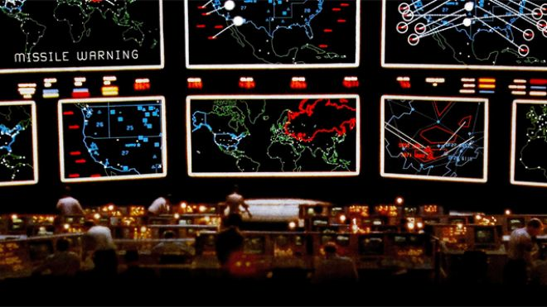
Projecting power into cyberspace
Notes:
The economic factors influencing threats in the early emergence of botnets were just the tip of the iceberg. As the Internet continued to be become more and more intertwined in the economic, political, and social fabric of our societies, the debate around free and open access to the Internet grew. The limiting of this free and open access for moral, political, or economic reasons, is ultimately a societal challenge, but the globally interconnected nature of our networks, such decisions impact not only our global aspiration, but the security and availability of our networks.

Slide 51
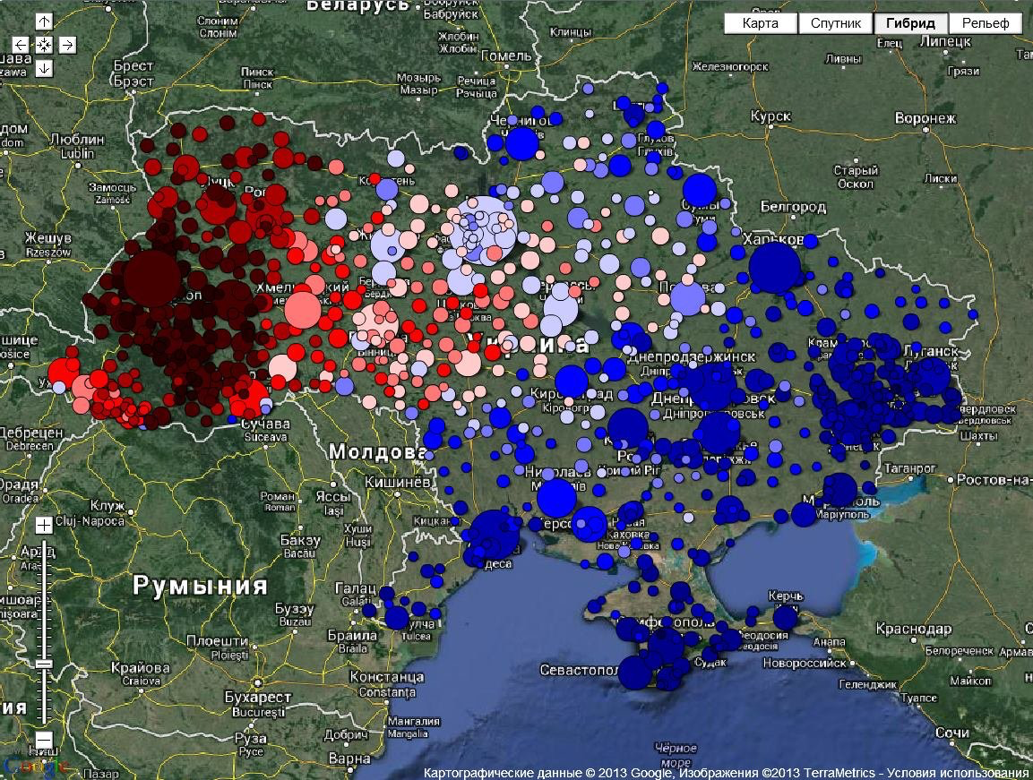

Slide 52
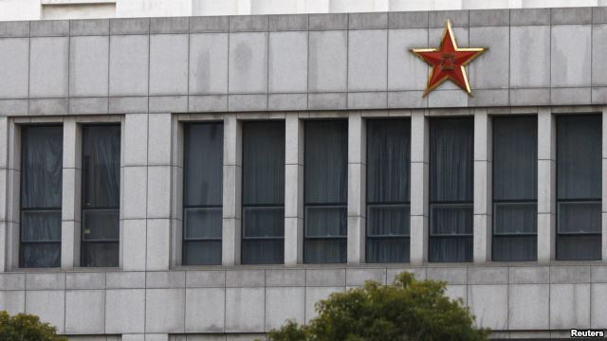

Slide 53
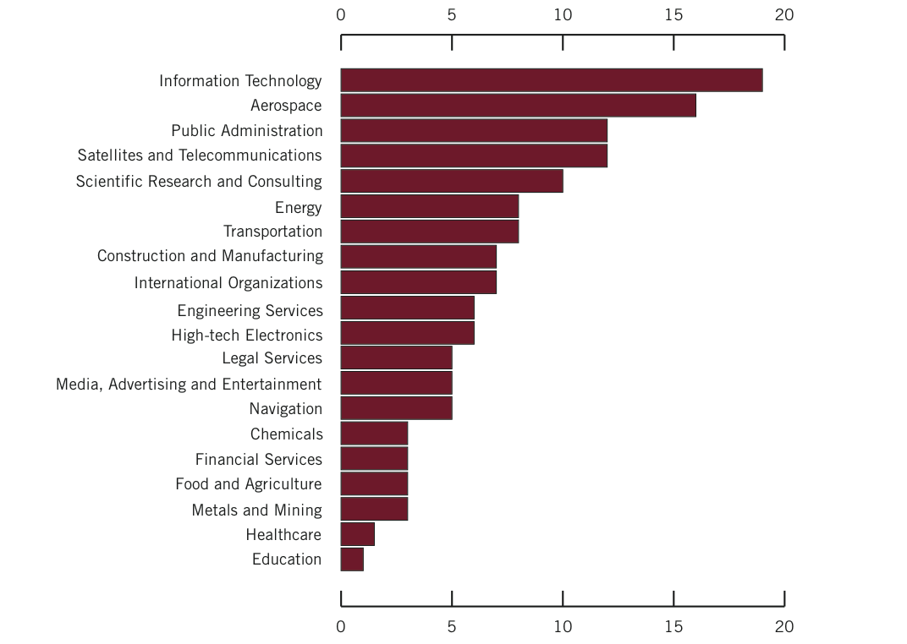


http://intelreport.mandiant.com/Mandiant_APT1_Report.pdf

Slide 54


Slide 55


Slide 56


Slide 57


Slide 58


Slide 59


Slide 60

The next ten years of Cyber Security

Slide 61


Mobile Devices & Cellular Networks are Pervasive
The number of mobile-connected devices will soon exceed the number of
people on earth.
vs
Mobile data traffic will grow at a compound annual growth rate (CAGR) of 66 percent from 2012 to 2017, reaching 11.2 exabytes per month by 2017.
Notes:
Mobile phones are the only digital system accessible to the majority of the planet.
Over 6.8 billion people connected through cellular networks today. Compared to:
7.1 billion people on Earth
~1.5 billion traditional Internet users
The number of mobile-connected devices will soon exceed the number of people on earth.
Video will generate most of the mobile data traffic
IM, MMS, SMS expected to exceed 10 trillion messages
Apps for commerce, healthcare, social networking, education …
1,000,000+ distinct active apps just in Apple’s App Store.
-----
Global mobile data traffic will increase 13-fold between 2012 and 2017. Mobile data traffic will grow at a compound annual growth rate (CAGR) of 66 percent from 2012 to 2017, reaching 11.2 exabytes per month by 2017.
Two-thirds of the world's mobile data traffic will be video by 2017. Mobile video will increase 16-fold between 2012 and 2017, accounting for over 66 percent of total mobile data traffic by the end of the forecast period.
---
By 2017 there will be nearly 1.4 mobile devices per capita. There will be over 10 billion mobile-connected devices in 2017, including machine-to-machine (M2M) modules-exceeding the world's population at that time (7.6 billion)
The average smartphone will generate 2.7 GB of traffic per month in 2017, an 8-fold increase over the 2012 average of 342 MB per month. Aggregate smartphone traffic in 2017 will be 19 times greater than it is today, with a CAGR of 81 percent.
By 2017, almost 21 exabytes of mobile data traffic will be offloaded to the fixed network by means of Wi-Fi devices and femtocells each month. Without Wi-Fi and femtocell offload, total mobile data traffic would grow at a CAGR of 74 percent between 2012 and 2017 (16-fold growth), instead of the projected CAGR of 66 percent (13-fold growth).
Info source
http://www.cisco.com/en/US/solutions/collateral/ns341/ns525/ns537/ns705/ns827/white_paper_c11-520862.html
Image source
http://www.cisco.com/en/US/solutions/collateral/ns341/ns525/ns537/ns705/ns827/white_paper_c11-520862.html
http://www.census.gov/popclock/

Slide 62

Mobility and Data Growth
Pervasiveness and Connectedness: Mobile devices have eclipsed traditional computers as points of entry for the Internet – “always-on always connected”
Mobile Data Services and Applications: Smartphones able to access data in a wide variety of forms from text messaging and web browsing to apps for everything and steaming services
Contextual Computing: Apps that take advantage of a user’s presence in time and space, combined w/ other relevant data, to deliver targeted and tailored content and services
FUTURE: SMART EVERTHING and CONNECTED
Notes:
Pervasiveness and Connectedness:
In 2012, 34% of homes no longer had a land line By 2015, wireless web access is expected to exceed wired use in the United States
Mobile web usage has overtaken PC web usage in China
Mobile Internet growth significantly outstrips desktop growth and analysts estimate mobile devices will be the predominant global access method by 2014 [16]. At the same time, mobile platforms such as the T-Mobile G1, Apple iPhone, and Nokia N- Series are reinventing the mobile landscape by opening up third-party development and by providing sophisticated productivity, communication, and application suites.
Mobile data services:
1,000,000+ distinct active apps just in Apple’s App Store.
Apps for commerce, healthcare, social networking, education …
In 2013, 17% of web browsing and 55% of social media use are done on mobile devices
Streaming services such as Netflix and YouTube
Location Services Contextual Computing:
Always-present computers, able to sense the objective and subjective aspects of a given situation, will augment our ability to perceive and act in the moment based on where we are, who we’re with, and our past experiences.
Deep understanding of the user and its surroundings to create tailored, relevant actions that the user can take
FUTURE: SMART EVERTHING and CONNECTED: Wearable computing and the “Internet of Things”
Wearable devices such as smart glasses will contribute to an explosion of new data being collected.
Bulk of mobile traffic will come from things rather than people: smart cars, smart appliances, smart meters, smart medical devices.

Slide 63
Big Data and Privacy
Amazon monitors our shopping preferences
Google tracks our browsing habits
Facebook captures our social interactions and more
Twitter tracks what on our minds in real-time
Wireless service operators track our connections, and who is nearby
…
Surge in gathering, storing, analyzing, … our personal data.
Notes:
Surge in gathering, storing, analyzing, and monetizing our personal data.
How could companies, such as Facebook and Twitter, that provide free service, be worth billions of dollars?
Monetizing User Data

Slide 64


Slide 65


Slide 66







Cloud and Virtualization
Notes:
Today, public cloud services are everywhere.
Many applications that we use everyday rely heavily on those services, especially Amazon’s EC2.
As a result, they have enormous impact on consumer Internet. For example, as of April 2012, 1/3 of all internet users will access web sites built in an amazon cloud at least once a day

Slide 67
Cyber-Physical Systems
Deeply integrating computation, communication, and control into physical systems
Transportation
Energy and Industrial Automation
Healthcare and Biomedical
Critical Infrastructure
Faster and safer aircraft
Improved use of airspace
Safer, more efficient cars
Homes and offices that are more energy efficient and cheaper to operate
Distributed micro-generation for the grid
Increased use of effective in-home care
More capable devices for diagnosis
New internal and external prosthetics
More reliable power grid
Highways that allow denser traffic with increased safety
Pervasive computation, sensing and control
Networked at multi- and extreme scales
Dynamically reorganizing/reconfiguring
High degrees of automation
Dependable operation with high assurance of reliability, safety, security and usability
Notes:
Cyber-physical systems aim to … Deeply integrate computation, communication, and control into physical systems
These are smart systems that have cyber technologies, both hardware and software, that are
deeply embedded in and interacting with physical components,
sensing AND changing the state of the real world
New smart cyber-physical systems will drive innovation and competition in sectors such as the power grid, transportation, buildings, medical technologies, and industrial automation advanced manufacturing.
Growing demand for capabilities and applications from Smart Grid, the Next Generation Air Transportation System, Intelligent [surface] Transportation Systems, to Smart Medical Technologies, Smart Buildings, and Smart Manufacturing.

Slide 68




Security of Cyber-Physical Systems
Embedded Medical Devices
Smart Grids
Industrial Control
Automobiles
Notes:
Each sector that becomes cyber-enabled becomes vulnerable to attacks.
Healthcare, education, and finance are already at risk, and physical infrastructure –manufacturing, energy production, and transportation – will be next.
This trend toward increasingly cyber-physical systems, the integration of computation, communication, and control into physical systems, will continue to offer new challenges.
For example, in healthcare, embedded wireless medical devices such as pacemakers are vulnerable to cyber attacks. Researchers have shown that by gaining wireless access to a combination heart defibrillator and pacemaker, they were able to reprogram it to shut down and to deliver jolts of electricity that could potentially have been fatal if the device had been in a person.
For example, in transportation, researchers have shown that by connecting to a standard diagnostic computer port included in late-model cars, they were able to do some unusual things, such as turning off the brakes, changing the speedometer reading, blasting hot air or music on the radio, and locking passengers in the car.
Consider, for example, the recent STUXNET worm. Discovered in July 2010, this worm targeted SCADA systems that were configured to monitor and control a kind of centrifuge used in Iranian nuclear fuel processing facilities.

